Slide 1
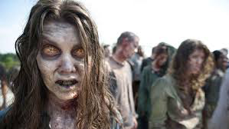
Active vs. Passive voice
A presentatioin

Slide 2
What is this?
Passive voice is wordy and weak compared to active voice
Can be used to hide/confuse information
Passive does not = past tense
Passive voice has something done upon it
Active voice does the action
It’s the difference from “hitting your friend and being hit by your friend”

Slide 3
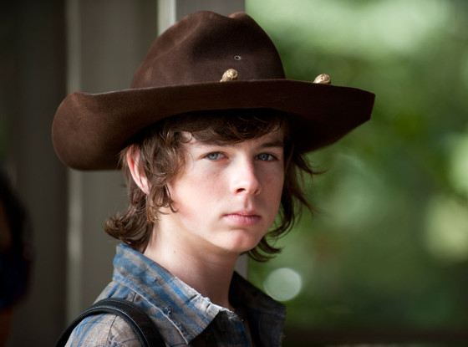
1. Identify the Verb
Mistakes were made
Carl was called for
The deputy hat was worn
Bob was bitten

Slide 4
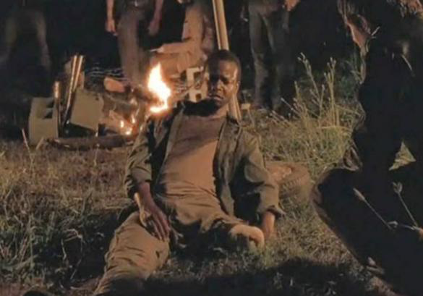
Mistakes were made
Carl was called for
The deputy hat was worn
Bob was bitten

Slide 5
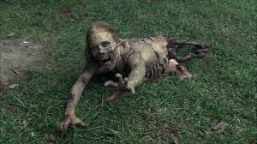
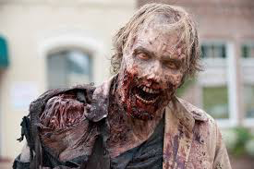
Use ‘By Zombies’
Mistakes were made by zombies.
Carl was called for by zombies.
The deputy hat was worn by zombies.
Bob was bitten by zombies.

Slide 6
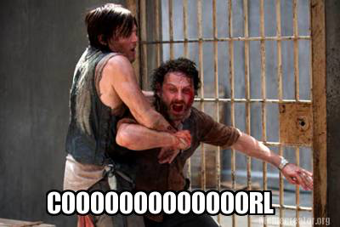
Identify the “doer”
Mistakes were made. (Who mad the mistakes?)
  _____________________.
Carl was called for.
  _____________________.
The deputy hat was worn.
  _____________________.
Bob was bitten.
  _____________________.

Slide 7
Location of Pictures
In order of appearance:
  https://encrypted-tbn3.gstatic.com/images?q=tbn:ANd9GcTLPaqWeWUzwXGXb7VIoaaKf2KZXZSudM4FlaYrDw7Wm6XtnPRNVg
  http://sweatpantsandcoffee.com/wp-content/uploads/2014/12/Chandler-Riggs-Carl-hat-Walking-Dead-AMC.jpg
  http://cdn.playbuzz.com/cdn/b95e19b2-c75a-46a7-8dc9-93d709d7dbd9/385cecc7-7877-41ae-bcdb-a5fff9249c91.jpg
  https://encrypted-tbn3.gstatic.com/images?q=tbn:ANd9GcQcLjdAxdIf_QHgKsL0ENxcxy7Wvhm3_Z7gazGrOW2uOGsEBr4_fw
  https://encrypted-tbn1.gstatic.com/images?q=tbn:ANd9GcQReLFFXsj6GtBfVT7Wmj1Qxrq0BkFxF-Ab-GtTwnxB15SfeQ_XhQ

