Slide 1

#
The Game of Dangling Modifiers

Slide 2
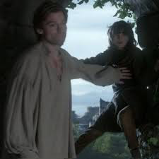
Don’t be like Bran!
Don’t be caught dangling (on a wall/sentence) like Bran, or you’ll be in trouble. ;)

Slide 3
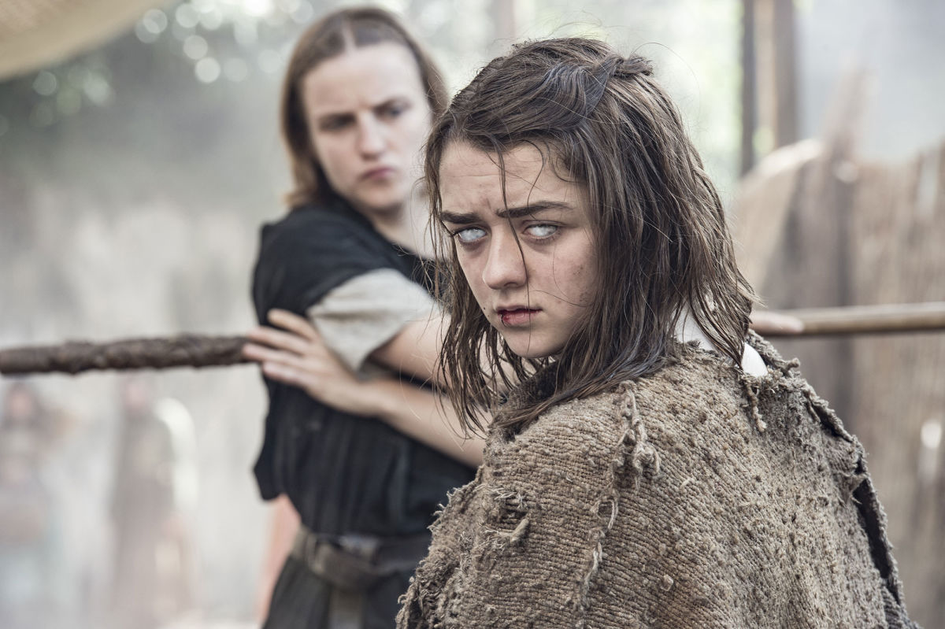
What is it?
A dangling modifier is a word or phrase that modifies a word not clearly in the sentence.
  A modifier describes, clarifies, or gives more detail about a concept.

Slide 4
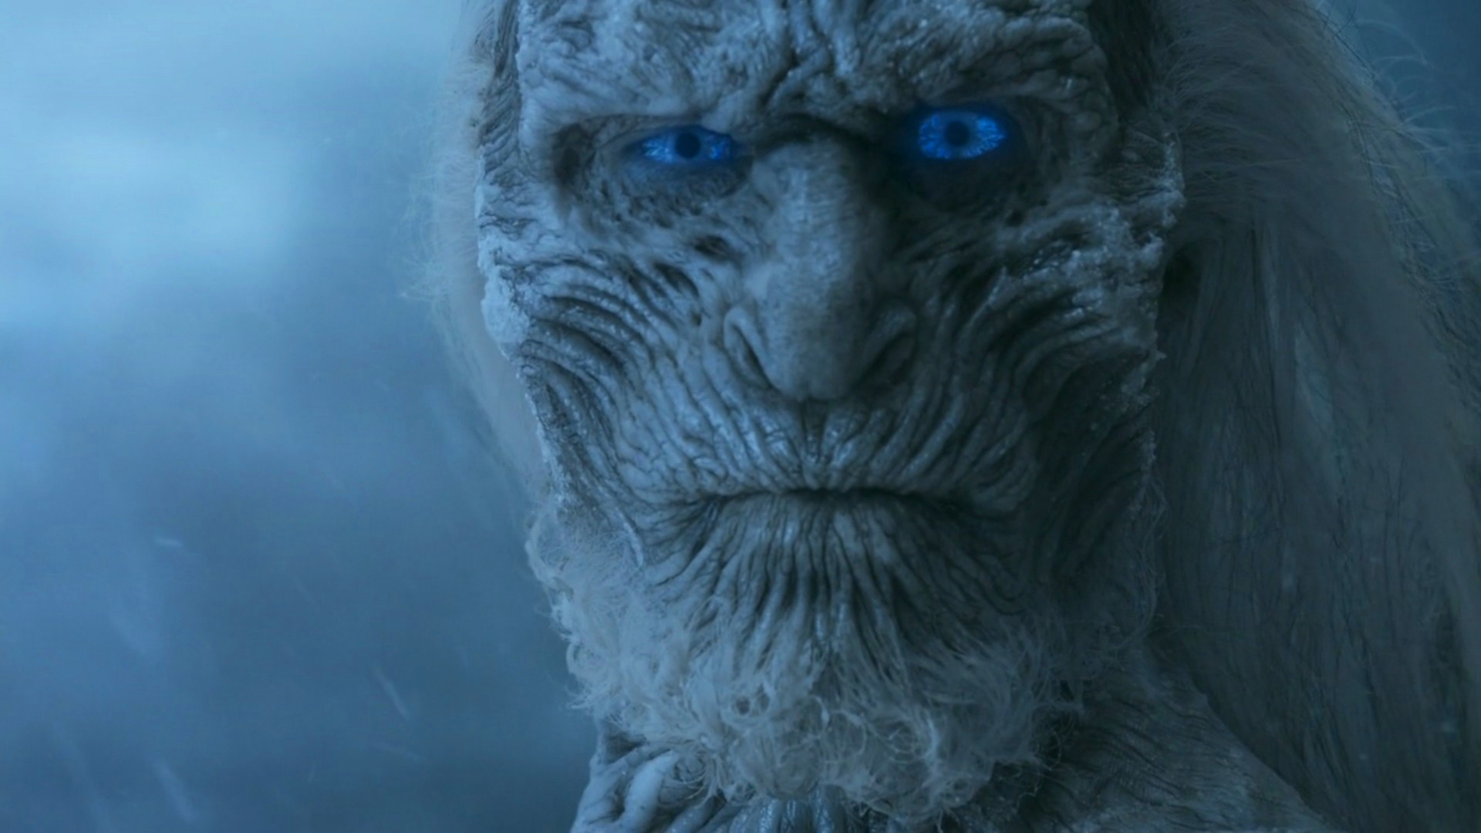
Examples
Having slayed a White Walker, Jon ate food.
Having slayed a White Walker, food was ate.
Look at the modifier. Which modifier slayed a White Walker?

Slide 5
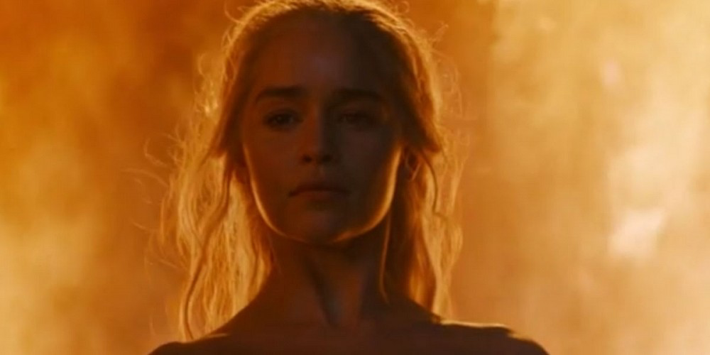
Strategies
1. Name the doer of the action in the main clause
2. Name the doer of the action (this makes it an introductory clause).
3. Combine them!
Strategies from https://owl.english.purdue.edu/owl/resource/597/1/

Slide 6
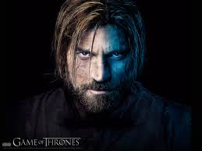
Example
After talking with Jaime, the war seemed inevitable.
  1. Name the doer:
  2. Change the phrase that dangles into an introductory clause by naming the doer of the action:
  3. Combine them
Notes:
After talking with Jaime, Brienne thought the war seemed inevitable.

Slide 7
Images
Game of Thrones Image: http://www.hbo.com/watch-free-episodes/game-of-thrones
Bran: http://awoiaf.westeros.org/images/thumb/7/7c/Jaime_and_Bran_HBO.jpg/300px-Jaime_and_Bran_HBO.jpg
Arya: http://www.newyorker.com/wp-content/uploads/2016/04/Larson-Game-of-Thrones-Returns-1200.jpg
White Walker: http://vignette1.wikia.nocookie.net/gameofthrones/images/0/0c/White_Walkers.png/revision/latest?cb=20150307215424
Dany: http://static.srcdn.com/slir/w1000-h500-q90-c1000:500/wp-content/uploads/Daenerys-Targaryen-Game-of-Thrones-Season-6.jpg
Jaime: http://images6.fanpop.com/image/photos/33700000/Game-of-Thrones-Season-3-game-of-thrones-33779412-1600-1200.jpg

